Slide 1




Noida Institute of Engineering and Technology, Greater Noida
Behavioural Design Pattern Part-1
Unit: IV
Design Pattern(ACSE0514)
Behavioural Design Pattern Part-1
Renu Panwar
Assistant Professor
CSE(AIML)
Course Details (B Tech 5th Sem)

Slide 2
Faculty Introduction
Name | Renu Panwar
Qualification | M. Tech. (CSE),B.TECH (CSE)
Designation | Assistant Professor
Department | Computer Science & Engineering-AIML
Total Experience | 12years
NIET Experience | 5.5 years
Subject Taught | Core Java and Advance Java, Artificial Intelligence, Soft Computing,Machine Learning, C Programming, Web Technology,Deep Learning, Operating System, OOPs ,C++,Design Pattern.

Slide 3
Evaluation Scheme
Python Web development with Django (Elective I)
Design Pattern (Elective II)

Slide 4
Syllabus
UNIT-IV: Behavioral Design Patterns Part: I
Behavioral Patterns Part: I, Chain of Responsibility, Command, Interpreter, Iterator Pattern.
Behavioral Patterns Part: II, Mediator, Memento, Observer, Patterns.

Slide 5
Design Pattern Applications
1. Real-time web analytics
2. Digital Advertising
3. E-Commerce
4. Publishing
5. Massively Multiplayer Online Games
6. Backend Services and Messaging
7. Project Management & Collaboration
8. Real time Monitoring Services
9.Live Charting and Graphing
10. Group and Private Chat

Slide 6
Course Objective
In this semester, the students will
Study how to show relationships and interactions between classes or objects.
Study to speed up the development process by providing well-tested, proven development/design paradigms.
Select a specific design pattern for the solution of a given design problem.
Create a catalog entry for a simple design pattern whose purpose and application are understood.

Slide 7
Course Outcomes (COs)
At the end of course, the student will be able to:
CO1 : Construct a design consisting of collection of modules.
CO2 : Exploit well known design pattern such as Factory, visitor etc.
CO3 : Distinguish between different categories of design patterns.
CO4 : Ability to common design pattern for incremental development.
CO5 : Identify appropriate design pattern for a given problem and design the software using pattern oriented architecture.

Slide 8
Program Outcomes (POs)
Engineering Graduates will be able to:
PO1 : Engineering Knowledge
PO2 : Problem Analysis
PO3 : Design/Development of solutions
PO4 : Conduct Investigations of complex problems
PO5 : Modern tool usage
PO6 : The engineer and society

Slide 9
Program Outcomes (POs)
Engineering Graduates will be able to:
PO7 : Environment and sustainability
PO8 : Ethics
PO9 : Individual and teamwork
PO10 : Communication
PO11 : Project management and finance
PO12 : Life-long learning

Slide 10
COs - POs Mapping
CO.K | PO1 | PO2 | PO3 | PO4 | PO5 | PO6 | PO7 | PO8 | PO9 | PO10 | PO11 | PO12
CO1 | 2 | 2 | 2 | 3 | 3 | - | - | - | - | - | - | -
CO2 | 3 | 2 | 3 | 2 | 3 | - | - | - | - | - | - | -
CO3 | 3 | 2 | 3 | 2 | 3 | - | - | - | - | - | - | -
CO4 | 3 | 2 | 3 | 2 | 3 | - | - | - | - | - | - | -
CO5 | 3 | 2 | 3 | 3 | 3 | - | - | - | - | - | - | -
AVG | 2.8 | 2.0 | 2.8 | 2.4 | 3.0 | - | - | - | - | - | - | -

Slide 11
Program Specific Outcomes(PSOs)
S. No. | Program Specific Outcomes (PSO) | PSO Description
1 | PSO1 | Understand to shows relationships and interactions between classes or objects of a pattern.
2 | PSO2 | Study to speed up the development process by providing well-tested, proven development
3 | PSO3 | Select a specific design pattern for the solution of a given design problem
4 | PSO4 | Create a catalogue entry for a simple design pattern whose purpose and application is understood.

Slide 12
COs - PSOs Mapping
CO.K | PSO1 | PSO2 | PSO3 | PSO4
CO1 | 3 | - | - | -
CO2 | 3 | 3 | - | -
CO3 | 3 | 3 | - | -
CO4 | 3 | 3 | - | -
CO5 | 3 | 3 | - | -

Slide 13
Program Educational Objectives (PEOs)
Program Educational Objectives (PEOs) | PEOs Description
PEOs | To have an excellent scientific and engineering breadth so as to comprehend, analyze, design and provide sustainable solutions for real-life problems using state-of-the-art technologies.
PEOs | To have a successful career in industries, to pursue higher studies or to support entrepreneurial endeavors and to face the global challenges.
PEOs | To have an effective communication skills, professional attitude, ethical values and a desire to learn specific knowledge in emerging trends, technologies for research, innovation and product development and contribution to society.
PEOs | To have life-long learning for up-skilling and re-skilling for successful professional career as engineer, scientist, entrepreneur and bureaucrat for betterment of society.

Slide 14
Result Analysis(Department Result & Subject Result & Individual result
Name of the faculty | Subject code | Result % of clear passed
Ms.Renu Panwar | ACSE0514 | 99

Slide 15
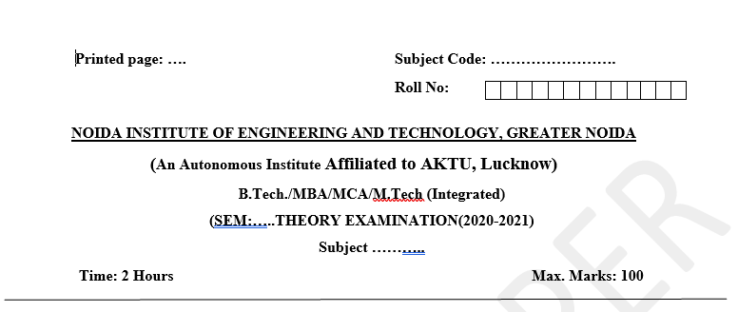
Pattern of Online External Exam Question Paper (100 marks)

Slide 16
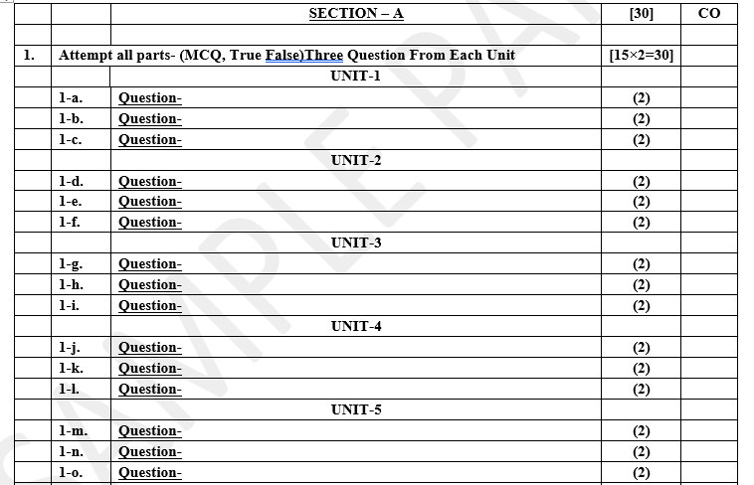
Pattern of Online External Exam Question Paper (100 marks)

Slide 17
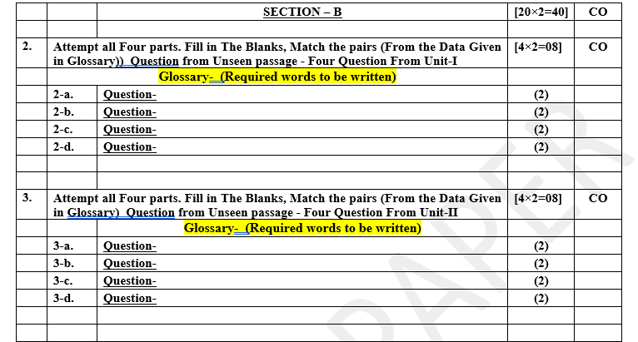
Pattern of Online External Exam Question Paper (100 marks)

Slide 18
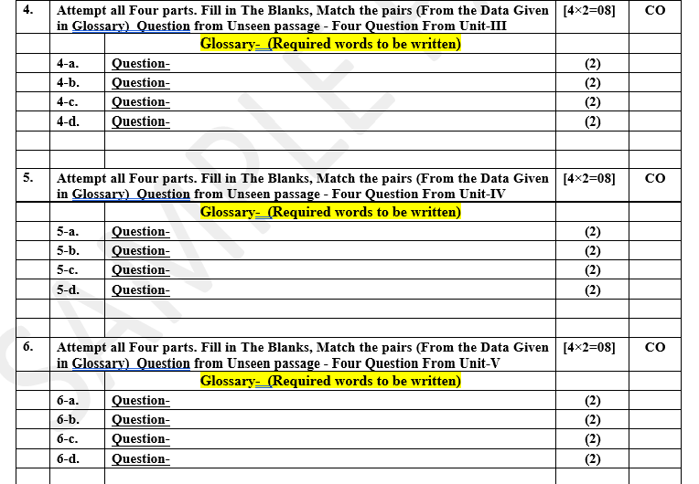
Pattern of Online External Exam Question Paper (100 marks)

Slide 19
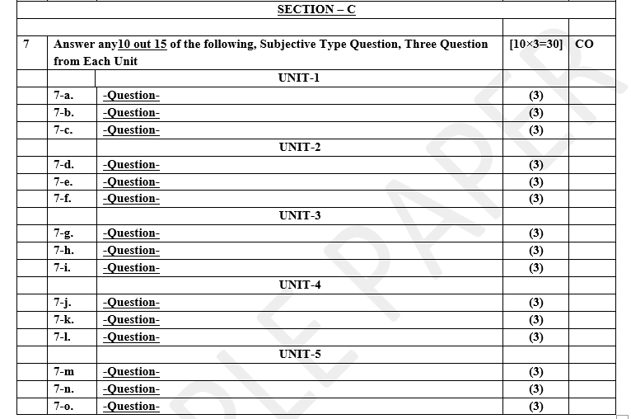
Pattern of Online External Exam Question Paper (100 marks)

Slide 20
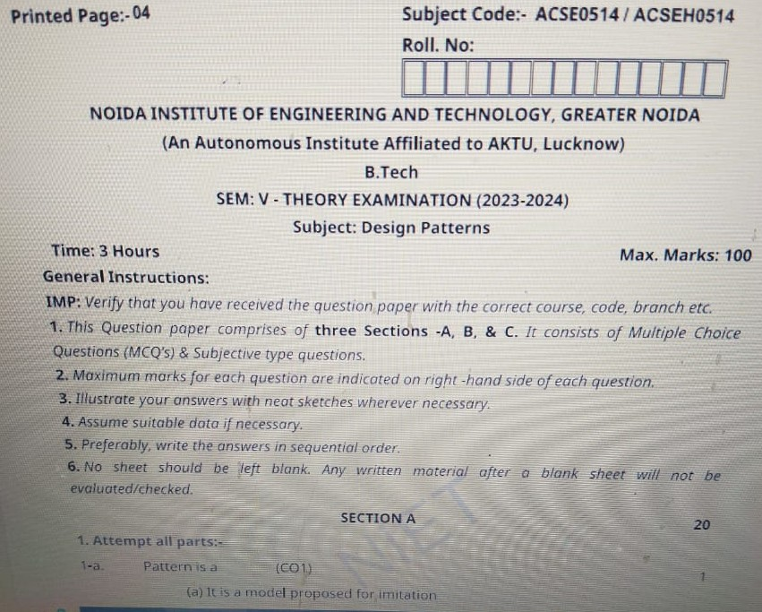
Design Pattern Previous Year Question Paper..

Slide 21
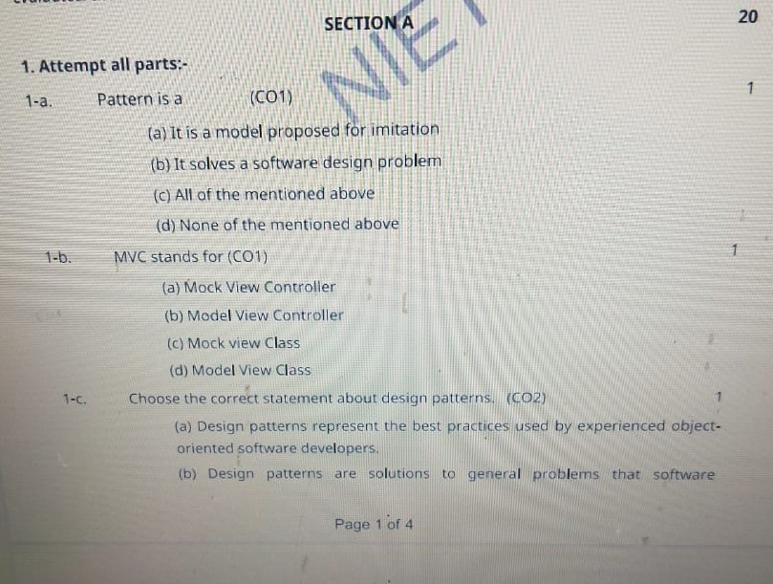
Design Pattern Previous Year Question Paper..

Slide 22
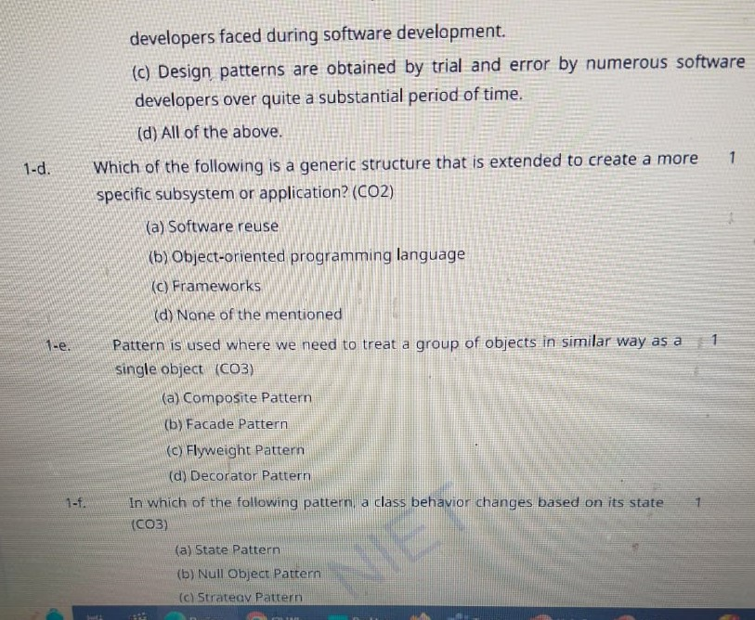
Design Pattern Previous Year Question Paper..

Slide 23
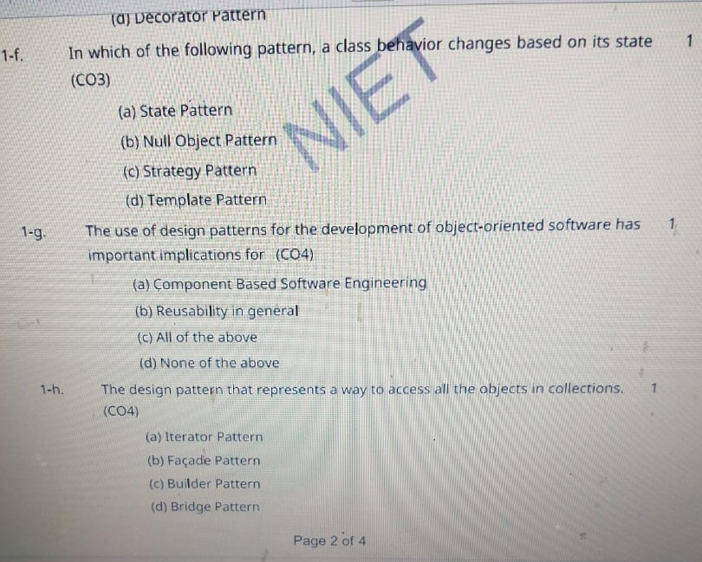
Design Pattern Previous Year Question Paper..

Slide 24
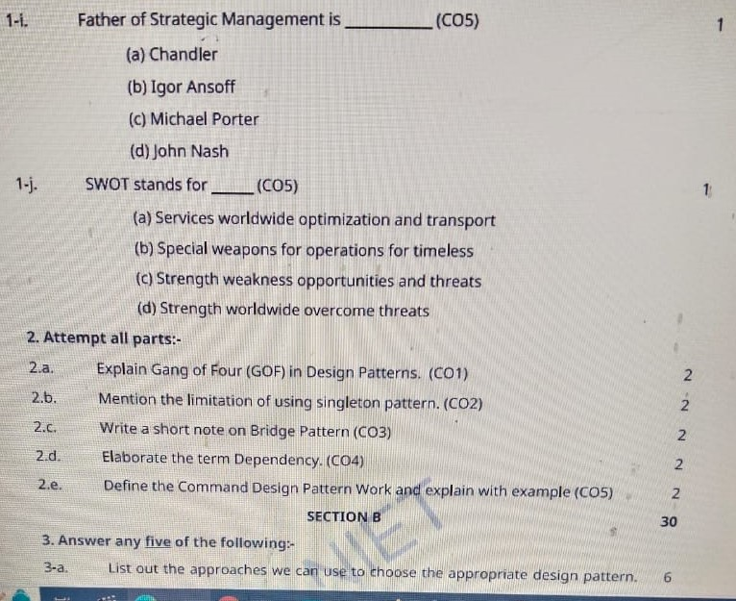
Design Pattern Previous Year Question Paper..

Slide 25
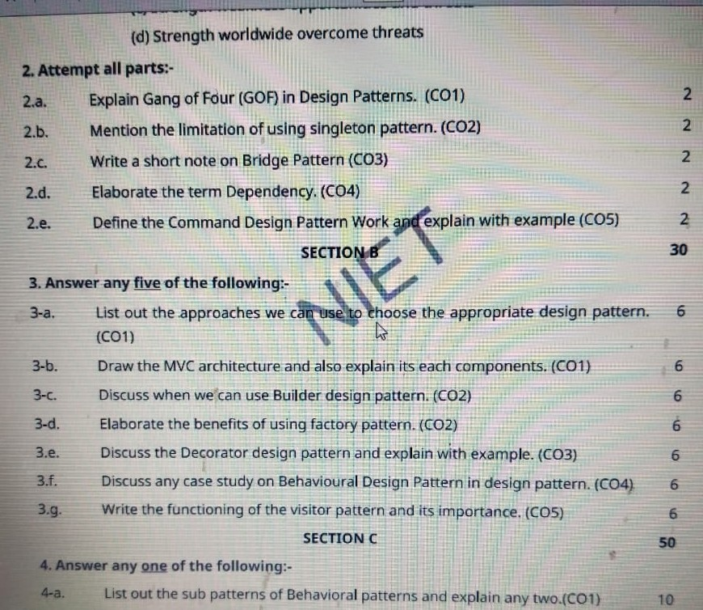
Design Pattern Previous Year Question Paper..

Slide 26
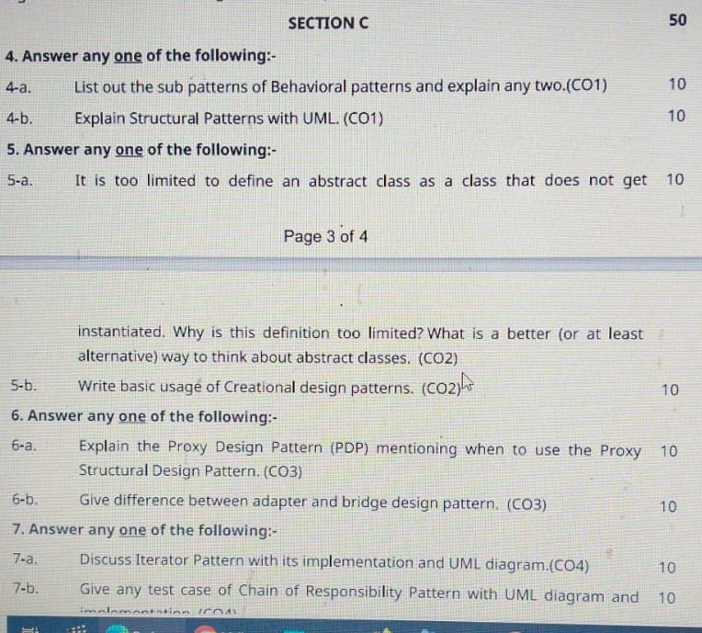
Design Pattern Previous Year Question Paper..

Slide 27
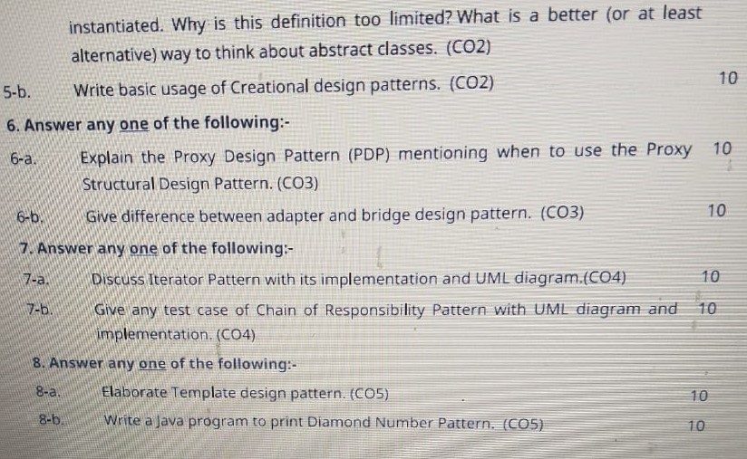
Design Pattern Previous Year Question Paper..

Slide 28
Prerequisite / Recap
Students should know object-oriented analysis and design.
Knowledge of Data structure and algorithm.
knowledge of Programming languages such as C/C++ etc.
Good problem-solving Skills.

Slide 29
Brief Introduction about the Subject with video
YouTube /other Video Links
https://youtu.be/rI4kdGLaUiQ?list=PL6n9fhu94yhUbctIoxoVTrklN3LMwTCmd
https://youtu.be/v9ejT8FO-7I?list=PLrhzvIcii6GNjpARdnO4ueTUAVR9eMBpc
https://youtu.be/VGLjQuEQgkI?list=PLt4nG7RVVk1h9lxOYSOGI9pcP3I5oblbx

Slide 30
Unit IV Content
Behavioral Design Patterns Part-I :
Chain Of Responsibility Pattern.
Command Pattern.
Interpreter Pattern.
Iterator Pattern.
Behavioral Design Patterns Part-II :
Mediator Pattern.
Memento Pattern.
Observer Pattern.

Slide 31
Unit IV Objective
In Unit IV, the students will be able to find
Definitions of terms and concepts.
The idea of a pattern.
The origins of all design patterns.
How Patterns Work in software design.
Scope of development activity: applications, toolkits, frameworks.
All Behavioral Pattern and their need.

Slide 32
Topic Objective
Topic : Behavioral Pattern, Chain Of Responsibility.
In this topic, the students will gain , The idea of a Behavioral design pattern, In these design patterns, the interaction between the objects should be in such a way that they can easily talk to each other and still should be loosely coupled.

Slide 33
Behavioral Design Patterns
Behavioral Design Pattern:-
Behavioral design patterns are concerned with the interaction and responsibility of objects.
In these design patterns, the interaction between the objects should be in such a way that they can easily talk to each other and still should be loosely coupled.
That means the implementation and the client should be loosely coupled in order to avoid hard coding and dependencies.

Slide 34
Behavioral Design Patterns
There are 10 types of behavioral design patterns:-
Chain of Responsibility Pattern
Command Pattern
Interpreter Pattern
Iterator Pattern
Mediator Pattern
Memento Pattern
Observer Pattern
State Pattern
Strategy Pattern
Template Pattern

Slide 35
Chain Of Responsibility Pattern
Chain Of Responsibility Pattern:-
A Chain of Responsibility Pattern says that just "avoid coupling the sender of a request to its receiver by giving multiple objects a chance to handle the request". For example, an ATM uses the Chain of Responsibility design pattern in money giving process.
In chain of responsibility, sender sends a request to a chain of objects. The request can be handled by any object in the chain.
In other words, we can say that normally each receiver contains reference of another receiver. If one object cannot handle the request then it passes the same to the next receiver and so on.

Slide 36
Implementation of (Chain Of Responsibility Pattern)
We have created an abstract class AbstractLogger with a level of logging. Then we have created three types of loggers extending the AbstractLogger. Each logger checks the level of message to its level and print accordingly otherwise does not print and pass the message to its next logger.
As the name suggests, the chain of responsibility pattern creates a chain of receiver objects for a request. This pattern decouples sender and receiver of a request based on type of request. This pattern comes under behavioral patterns.
In this pattern, normally each receiver contains reference to another receiver. If one object cannot handle the request then it passes the same to the next receiver and so on.

Slide 37
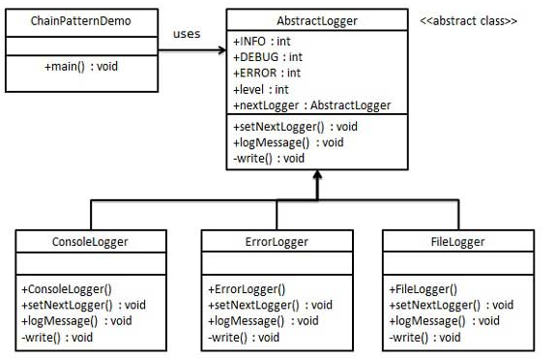
UML\Structure for Chain Of Responsibility

Slide 38
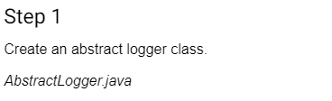
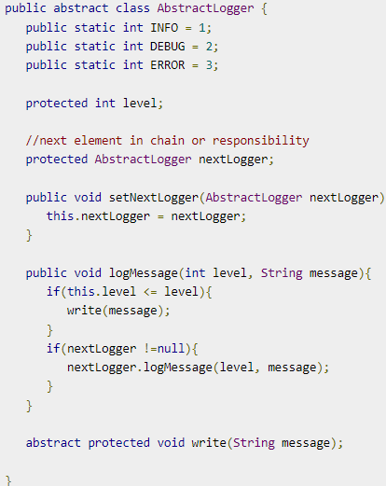
Implementation of (Chain Of Responsibility Pattern)

Slide 39
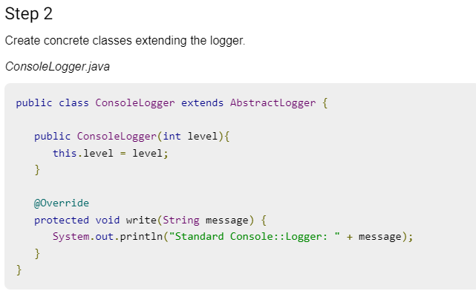
Implementation of (Chain Of Responsibility Pattern)

Slide 40
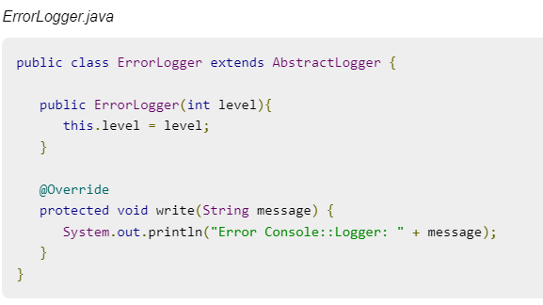
Implementation of (Chain Of Responsibility Pattern)
Step -2 Cont.……..

Slide 41
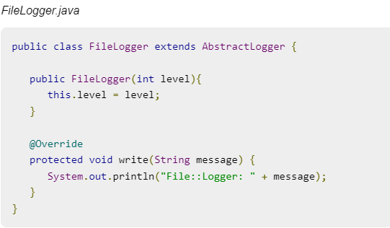
Implementation of (Chain Of Responsibility Pattern)
Step -2 Cont.……..

Slide 42
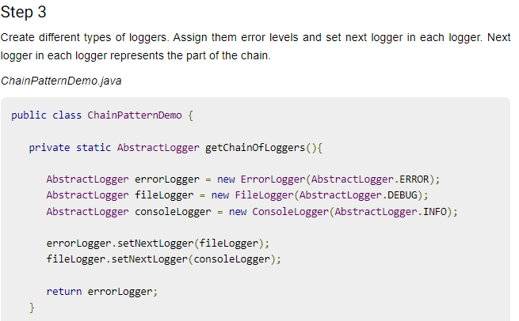
Implementation of (Chain Of Responsibility Pattern)

Slide 43
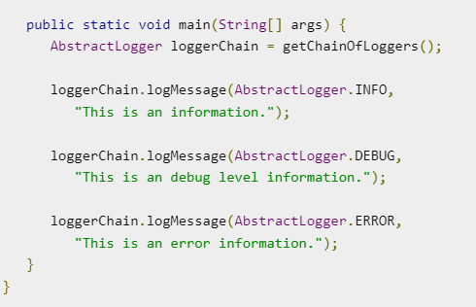
Implementation of (Chain Of Responsibility Pattern)
Step -3 Cont.……..

Slide 44
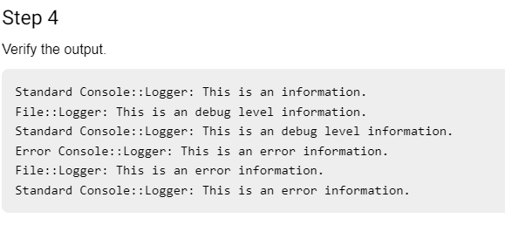
Implementation of (Chain Of Responsibility Pattern)

Slide 45
Topic Objective
Topic : Command Pattern
In this topic, the students will gain , The idea of a Command pattern is a data driven design pattern and falls under behavioral pattern category. A request is wrapped under an object as command and passed to invoker object. Invoker object looks for the appropriate object which can handle this command and passes the command to the corresponding object which executes the command.

Slide 46
Command Pattern
Command Pattern:-
A Command Pattern says that "encapsulate a request under an object as a command and pass it to invoker object. Invoker object looks for the appropriate object which can handle this command and pass the command to the corresponding object and that object executes the command".
It is also known as Action or Transaction.
It separates the object that invokes the operation from the object that actually performs the operation.
It makes easy to add new commands, because existing classes remain unchanged.

Slide 47
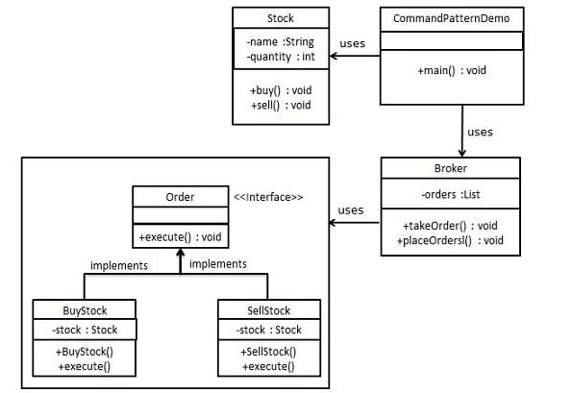
UML\Structure for Command Pattern

Slide 48
Implementation of (Command Pattern)
We have created an interface Order which is acting as a command. We have created a Stock class which acts as a request. We have concrete command classes BuyStock and SellStock implementing Order interface which will do actual command processing. A class Broker is created which acts as an invoker object. It can take and place orders.
Broker object uses command pattern to identify which object will execute which command based on the type of command. CommandPatternDemo, our demo class, will use Broker class to demonstrate command pattern.
Command pattern is a data driven design pattern and falls under behavioral pattern category. A request is wrapped under an object as command and passed to invoker object.

Slide 49
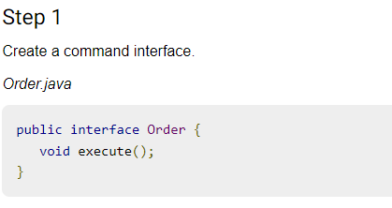
Implementation of (Command Pattern)

Slide 50
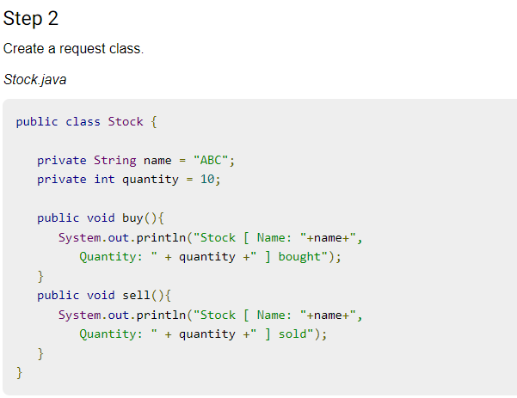
Implementation of (Command Pattern)

Slide 51
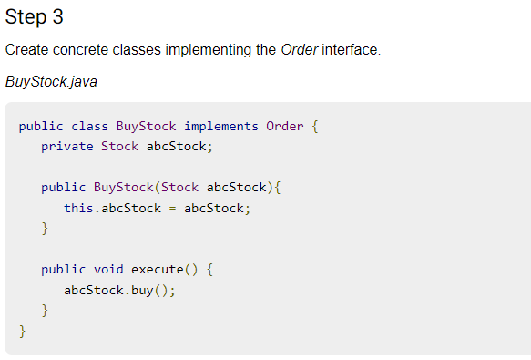
Implementation of (Command Pattern)

Slide 52
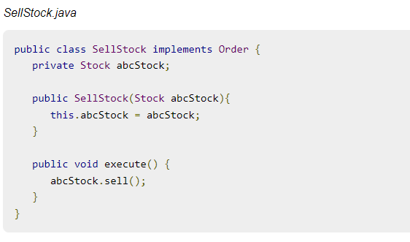
Implementation of (Command Pattern)
Step -3 Cont.……..

Slide 53
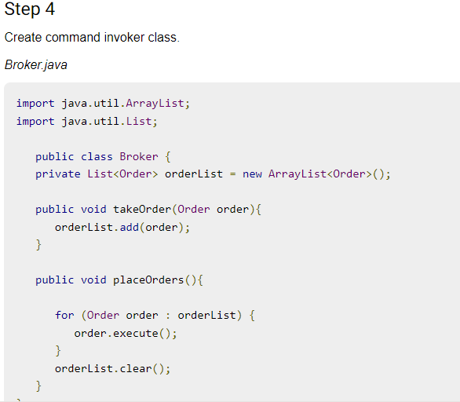
Implementation of (Command Pattern)

Slide 54
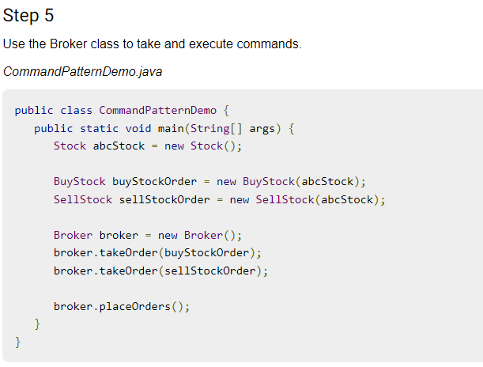
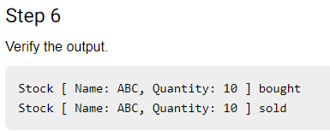
Implementation of (Command Pattern)

Slide 55
Topic Objective
Topic : Interpreter Pattern
In this topic, the students will gain , The idea of a Interpreter Pattern An Interpreter Pattern says that "to define a representation of grammar of a given language, along with an interpreter that uses this representation to interpret sentences in the language".

Slide 56
Interpreter Pattern
Interpreter Pattern:-
An Interpreter Pattern says that "to define a representation of grammar of a given language, along with an interpreter that uses this representation to interpret sentences in the language".
Basically the Interpreter pattern has limited area where it can be applied. We can discuss the Interpreter pattern only in terms of formal grammars but in this area there are better solutions that is why it is not frequently used.
This pattern can applied for parsing the expressions defined in simple grammars and sometimes in simple rule engines.

Slide 57
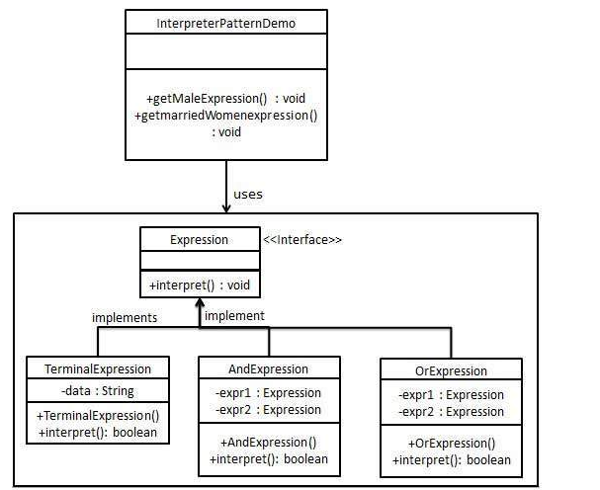
UML\Structure for Interpreter Pattern

Slide 58
Implementation of (Interpreter Pattern)
We are going to create an interface Expression and concrete classes implementing the Expression interface. A class TerminalExpression is defined which acts as a main interpreter of context in question. Other classes OrExpression, AndExpression are used to create combinational expressions.
InterpreterPatternDemo, our demo class, will use Expression class to create rules and demonstrate parsing of expressions.
Interpreter pattern provides a way to evaluate language grammar or expression. This type of pattern comes under behavioral pattern. This pattern involves implementing an expression interface which tells to interpret a particular context.

Slide 59
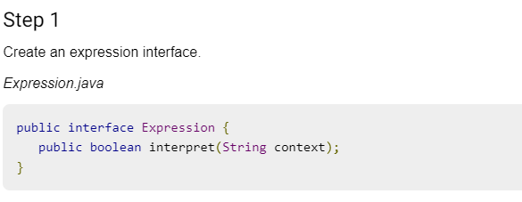
Implementation of (Interpreter Pattern)

Slide 60
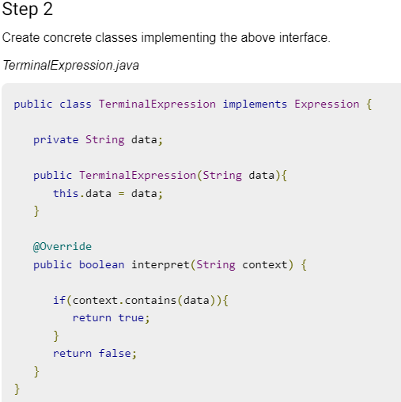
Implementation of (Interpreter Pattern)

Slide 61
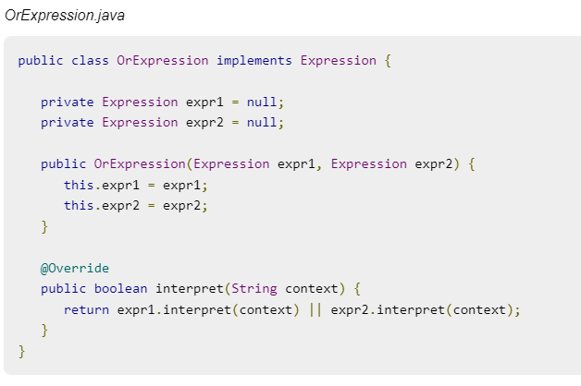
Implementation of (Interpreter Pattern)
Step -2 Cont.……..

Slide 62
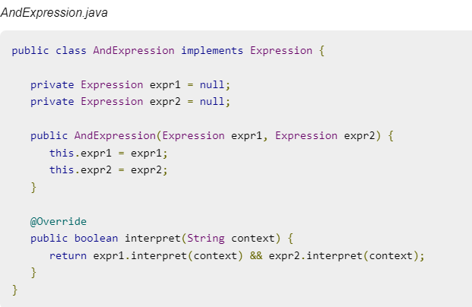
Implementation of (Interpreter Pattern)
Step -2 Cont.……..

Slide 63
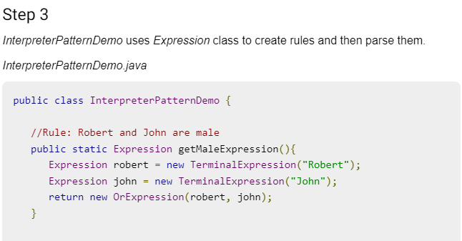
Implementation of (Interpreter Pattern)

Slide 64
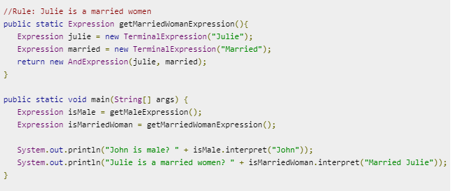
Implementation of (Interpreter Pattern)
Step -3 Cont.……..

Slide 65
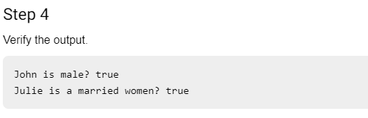
Implementation of (Interpreter Pattern)

Slide 66
Topic Objective
Topic : Iterator Pattern
In this topic, the students will gain , The idea an Iterator PatternAccording to GoF, Iterator Pattern is used "to access the elements of an aggregate object sequentially without exposing its underlying implementation".The Iterator pattern is also known as Cursor.In collection framework, we are now using Iterator that is preferred over Enumeration.

Slide 67
Iterator Pattern
Iterator Pattern:-
Iterator pattern is very commonly used design pattern in Java and .Net programming environment. This pattern is used to get a way to access the elements of a collection object in sequential manner without any need to know its underlying representation.
Iterator pattern falls under behavioral pattern category.
It supports variations in the traversal of a collection. It simplifies the interface to the collection.
It is used When you want to access a collection of objects without exposing its internal representation.

Slide 68
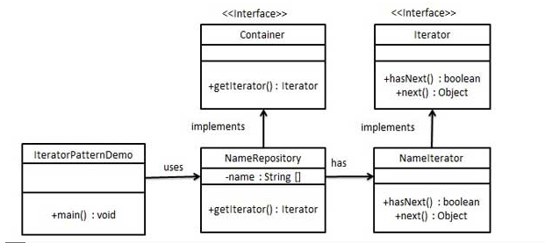
UML\Structure for Iterator Pattern

Slide 69
Implementation of (Iterator Pattern)
We're going to create a Iterator interface which narrates navigation method and a Container interface which retruns the iterator . Concrete classes implementing the Container interface will be responsible to implement Iterator interface and use it
IteratorPatternDemo, our demo class will use NamesRepository, a concrete class implementation to print a Names stored as a collection in NamesRepository.
It is used When there are multiple traversals of objects need to be supported in the collection.

Slide 70
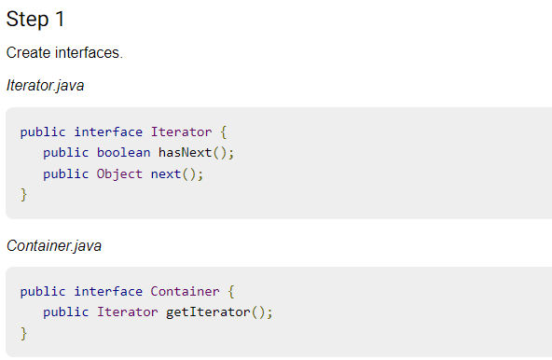
Implementation of (Iterator Pattern)

Slide 71
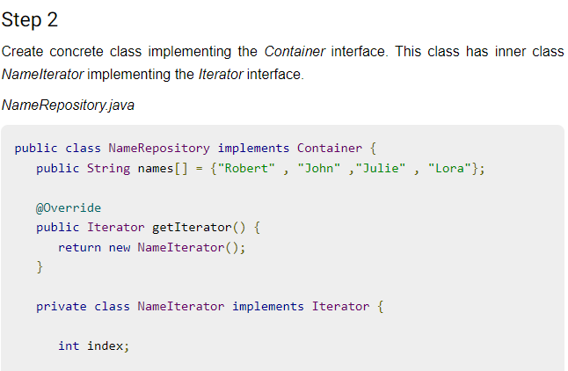
Implementation of (Iterator Pattern)

Slide 72
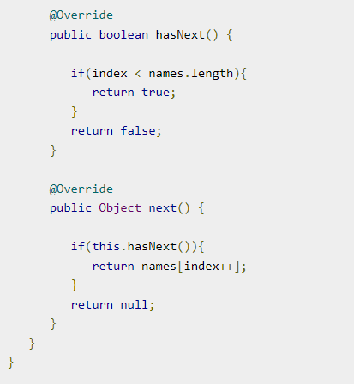
Step -2 Cont.……..

Slide 73
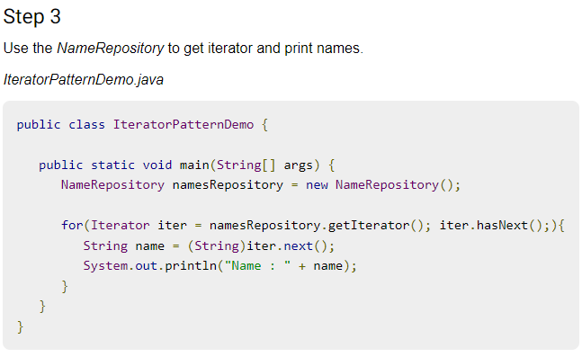
Implementation of (Iterator Pattern)

Slide 74
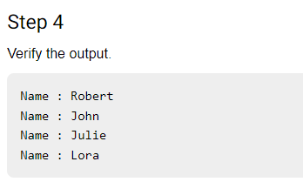
Implementation of (Iterator Pattern)

Slide 75
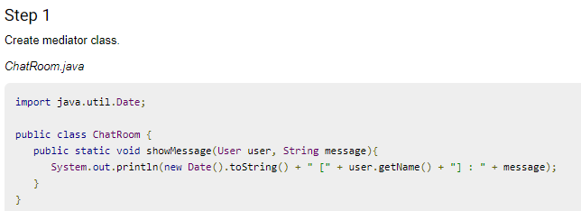
Implementation of (Mediator Pattern)

Slide 76
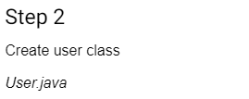
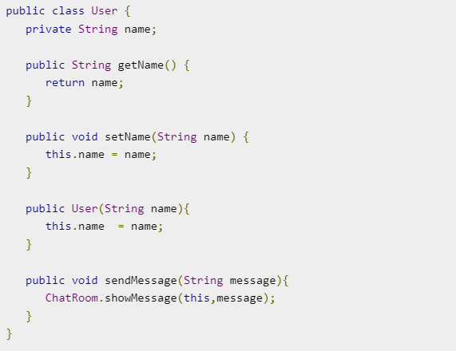
Implementation of (Mediator Pattern)

Slide 77
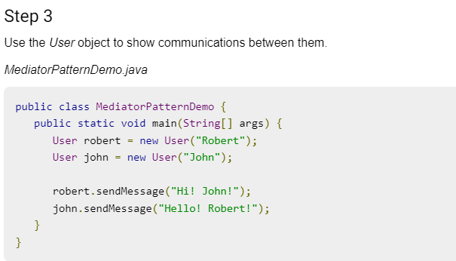
Implementation of (Mediator Pattern)

Slide 78
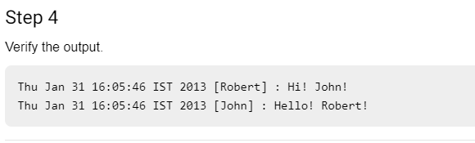
Implementation of (Mediator Pattern)

Slide 79
Topic Objective
Topic : Memento Pattern
In this topic, the students will gain , The idea an Memento Pattern i.e Memento pattern is used to restore state of an object to a previous state. Memento pattern falls under behavioral pattern category.

Slide 80
Memento Pattern
Memento Pattern:-
A Memento Pattern says that "to restore the state of an object to its previous state". But it must do this without violating Encapsulation. Such case is useful in case of error or failure.The Memento pattern is also known as Token.
Undo or backspace or ctrl+z is one of the most used operation in an editor. Memento design pattern is used to implement the undo operation. This is done by saving the current state of the object as it changes state.
It preserves encapsulation boundaries. It simplifies the originator.

Slide 81
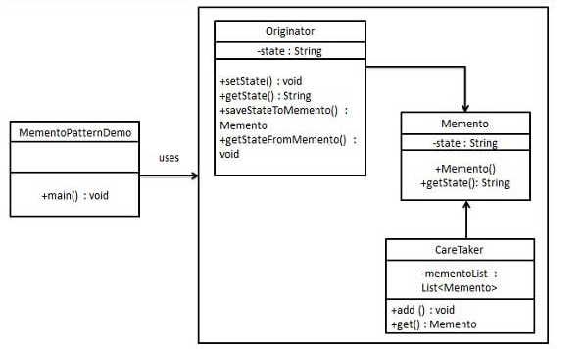
UML\Structure for Memento Pattern

Slide 82
Implementation of (Memento Pattern)
Memento pattern uses three actor classes. Memento contains state of an object to be restored. Originator creates and stores states in Memento objects and Caretaker object is responsible to restore object state from Memento. We have created classes Memento, Originator and CareTaker.
MementoPatternDemo, our demo class, will use CareTaker and Originator objects to show restoration of object states.
It is used in Undo and Redo operations in most software.
It is also used in database transactions.

Slide 83

Implementation of (Memento Pattern)

Slide 84


Implementation of (Memento Pattern)

Slide 85

Implementation of (Memento Pattern)

Slide 86


Implementation of (Memento Pattern)

Slide 87

Implementation of (Memento Pattern)

Slide 88
Topic Objective
Topic : Observer Pattern
In this topic, the students will gain , The idea an Observer Pattern i.e An Observer Pattern says that "just define a one-to-one dependency so that when one object changes state, all its dependents are notified and updated automatically".

Slide 89
Observer Pattern
Observer Pattern:-
Observer pattern is used when there is one-to-many relationship between objects such as if one object is modified, its depenedent objects are to be notified automatically. Observer pattern falls under behavioral pattern category.
It describes the coupling between the objects and the observer.It provides the support for broadcast-type communication.When the change of a state in one object must be reflected in another object without keeping the objects tight coupled.
When the framework we writes and needs to be enhanced in future with new observers with minimal chamges.

Slide 90

UML\Structure for Observer Pattern

Slide 91
Implementation of (Observer Pattern)
Observer pattern uses three actor classes. Subject, Observer and Client. Subject is an object having methods to attach and detach observers to a client object. We have created an abstract class Observer and a concrete class Subject that is extending class Observer.
ObserverPatternDemo, our demo class, will use Subject and concrete class object to show observer pattern in action.
Observer pattern is used when there is one-to-many relationship between objects such as if one object is modified, its depenedent objects are to be notified automatically. Observer pattern falls under behavioral pattern category.

Slide 92

Implementation of (Observer Pattern)

Slide 93

Implementation of (Observer Pattern)
Step -1 Cont.……..

Slide 94

Implementation of (Observer Pattern)

Slide 95


Implementation of (Observer Pattern)

Slide 96


Implementation of (Observer Pattern)
Step -3 Cont.……..

Slide 97


Implementation of (Observer Pattern)
Step -3 Cont.……..

Slide 98

Implementation of (Observer Pattern)

Slide 99

Implementation of (Observer Pattern)

Slide 100
Daily Quiz
Which of the following are levels of design focus that can be used to categorize WebApp patterns?
Behavioral patterns
Functional patterns
Layout patterns
Navigation patterns
Both b and d
Which of the following describes the Facade pattern correctly?
This pattern allows a user to add new functionality to an existing object without altering its structure
This pattern is used where we need to treat a group of objects in similar way as a single object
This pattern hides the complexities of the system and provides an interface to the client using which the client can access the system
This pattern is primarily used to reduce the number of objects created and to decrease memory footprint and increase performance

Slide 101
Daily Quiz
The use of design patterns for the development of object-oriented software has important implications for
Component-based software engineering
Reusability in general
All of the above
None of the above
Attach additional responsibilities to an object dynamically. It provides a flexible alternative to sub classing for extending functionality.
Chain of responsibility
Adapter
Decorator
Composite

Slide 102
Weekly Assignment
Explain the Chain of Responsibility Pattern?
Explain the advantage of Chain of Responsibilities Pattern and when it is used?.
How is Bridge pattern is different from the Adapter pattern?
What's the difference between the Dependency Injection and Service Locator patterns?
Explain the Intercepting Filter Design Pattern and also mention its benefits?

Slide 103
Topic Link ( YouTube & NPTEL Video Links)
YouTube /other Video Links
https://youtu.be/rI4kdGLaUiQ?list=PL6n9fhu94yhUbctIoxoVTrklN3LMwTCmd
https://youtu.be/v9ejT8FO-7I?list=PLrhzvIcii6GNjpARdnO4ueTUAVR9eMBpc
https://youtu.be/VGLjQuEQgkI?list=PLt4nG7RVVk1h9lxOYSOGI9pcP3I5oblbx

Slide 104
MCQ
1. Design patterns can be classified in _______ categories.
1
2
3
4
2. Which design patterns are specifically concerned with communication between objects?
Creational Patterns
Structural Patterns
Behavioral Patterns
J2EE Patterns

Slide 105
MCQ
3. Which design pattern provides a single class which provides simplified methods required by client and delegates call to those methods?
Adapter pattern
Builder pattern
Facade pattern
Prototype pattern
4. Which design pattern suggests multiple classes through which request is passed and multiple but only relevant classes carry out operations on the request?
Singleton pattern
Chain of responsibility pattern
State pattern
Bridge pattern

Slide 106
Glossary Questions
Top 10 design pattern interview questions
Explain Data Access Object (DAO) pattern?
Mention what is the difference between VO and JDO?
Explain the benefits of design patterns in Java.
Describe the proxy pattern.
Differentiate ordinary and abstract factory design patterns.
What do you think are the advantages of builder design patterns?
How is the bridge pattern different from the adapter pattern?
What is a command pattern?
Describe the singleton pattern along with its advantages and disadvantages.
What are anti patterns?

Slide 107
Expected Questions for University Exam
What Is Abstract Factory Pattern?
How are design patterns categorized?
Explain the benefits of design patterns in Java.
Describe the factory pattern.
Differentiate ordinary and abstract factory design patterns.
What do you think are the advantages of builder design patterns?
How is the bridge pattern different from the adapter pattern?
What is a command pattern?
Describe the singleton pattern along with its advantages and disadvantages.
What are anti patterns?

Slide 108
Summary
Till Now we understand, Behavioral design patterns are concerned with the interaction and responsibility of objects.
The idea of a Command pattern is a data driven design pattern and falls under behavioral pattern category.
The idea an Observer Pattern i.e An Observer Pattern says that "just define a one-to-one dependency so that when one object changes state, all its dependents are notified and updated automatically".
The idea an Memento Pattern i.e Memento pattern is used to restore state of an object to a previous state. Memento pattern falls under behavioral pattern category. An Observer Pattern says that "just define a one-to-one dependency so that when one object changes state, all its dependents are notified and updated automatically.

Slide 109
References
Eric Freeman, Elisabeth Freeman, Kathy Sierra, Bert Bates Head First Design Patterns, 2004, O'Reilly.
Erich Gamma, Richard Helm, Ralph Johnson, John Vlissides Design Patterns: Elements of Reusable Object-oriented Software Addison-Wesley, 1995.
Design Pattern s By Erich Gamma , Pearson Education, 2001.
Patterns in JAVA Volume -I By Mark Grand, Wiley Dream.2002.
Patterns of Enterprise Application Architecture , Pearson Education India, 2002.

Slide 110
THANK YOU

